Slide 1
The Basics about SLAM
Xiang Gao
Tsinghua Univ.
2016.3

Slide 2
Contents
Def. of SLAM
Visual Odometry
Optimization
Loop Closure
Map
Conclusion

Slide 3
1.Def. of SLAM

Slide 4
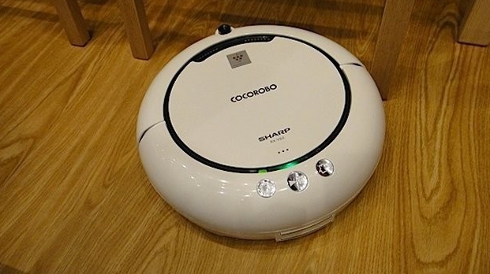
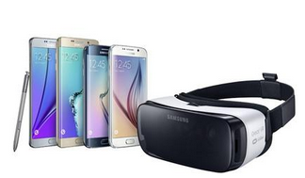
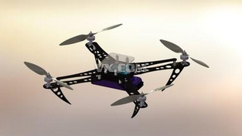
1. Def. of SLAM
SLAM: Simultaneous Localization and Mapping
Applications: Robotics, UAVs, Cars, AR/VR, Smart phones, etc.

Slide 5
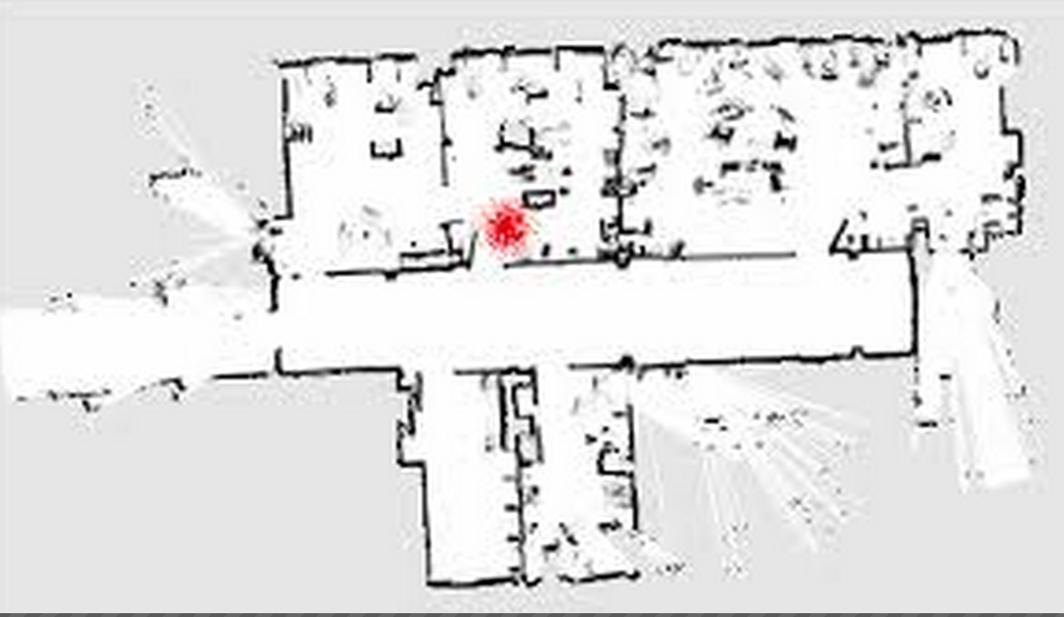
1. Def. of SLAM
Localization
Where am I?
Mapping
What is around me?
Needs accurate map
Needs accurate position
Simultaneously minimization both error

Slide 6
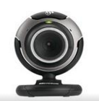
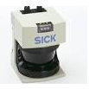
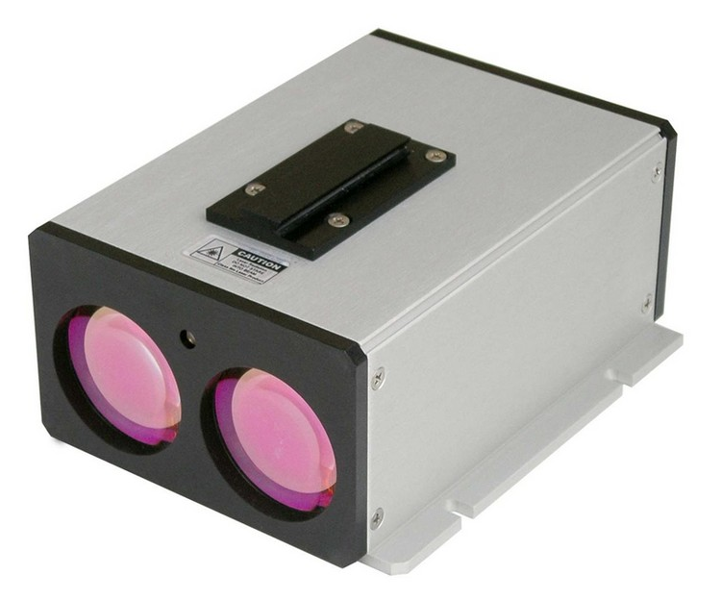
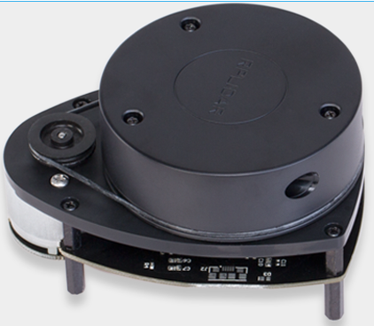
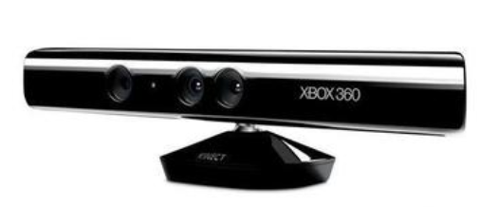
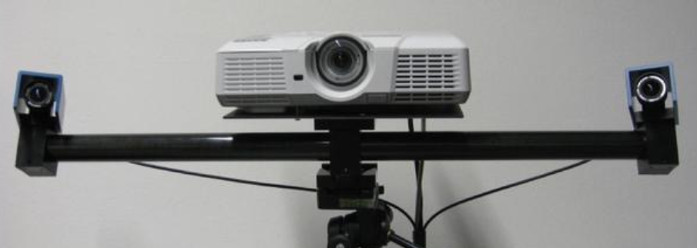
1. Def. of SLAM
The methods and difficulty of SLAM depend heavily on the equipped sensors.
Sensors
Lasers
Accurate
Fast
Long history in research
Heavy
Expensive
Examples: SICK, Velodyne, Rplidar
Cameras
Cheap
Light-weight
Rich information
High computation cost
Work under assumptions
Categories: monocular, stereo, RGBD

Slide 7
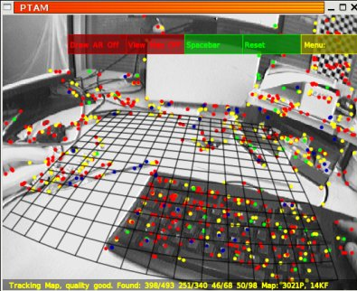
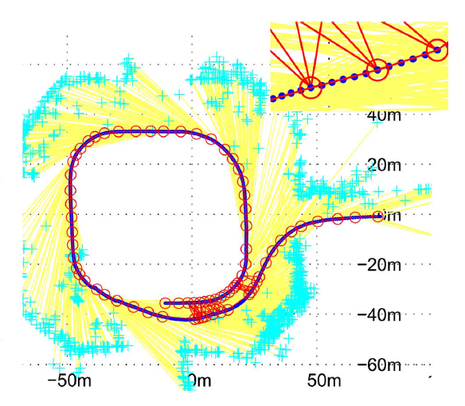
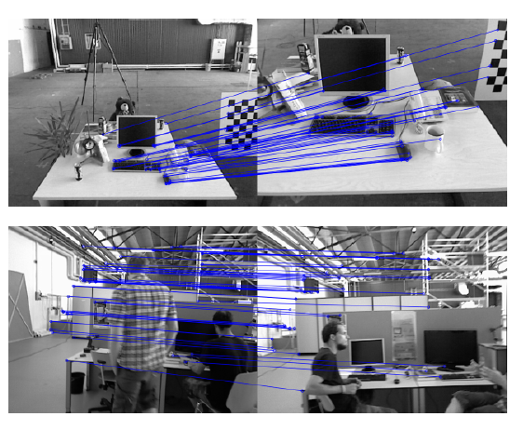
1. Def. of SLAM
vSLAM: SLAM that uses cameras as the only or main sensor.
Active research area in recent decades.
Considered basically solved in rigid and static environments.

Slide 8
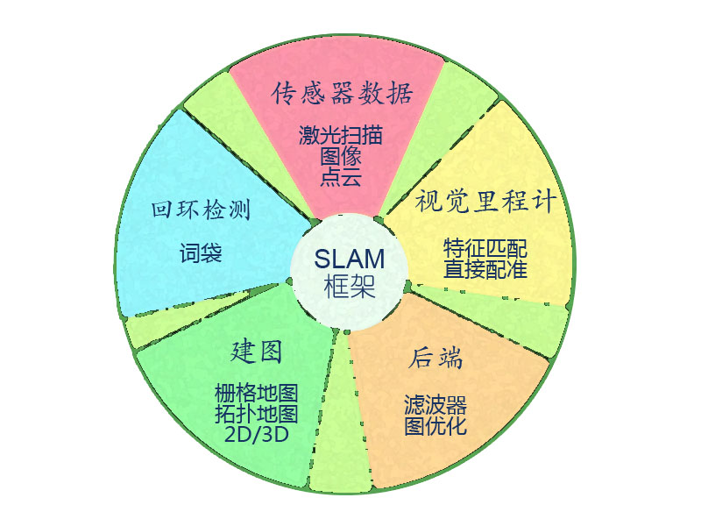
1. Def. of SLAM
Common components in a vSLAM:
Sensor data process
Visual Odometry
Backend (Optimization)
Mapping
Loop closure detection
vSLAM research status:
Basically solved in theory: filter & optimization
Demo in rigid and static environments
Several qualified open source solutions
SLAM is more like a concept than a single algorithm.*
* Soren Rissgaard and Morten Rufus Blas, SLAM for dummies, MIT lab.

Slide 9
1. Def. of SLAM
传感器数据
配准
后端
输出结果
轨迹
地图
图像
点云
特征匹配+ICP
直接配准
滤波器
优化
回环检测
Loop Closing

Slide 10
2. Visual Odometry

Slide 11
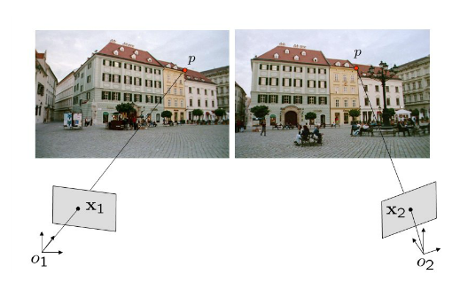
2. Visual Odometry
Visual Odometry
Estimate the ego-motion between frames.
Basically Two-view geometry.
Problem
Data: a set of images
Goal: Estimate the camera motion and reconstruct the environment
Structure-from-Motion (SfM) or vSLAM

Slide 12
2. Visual Odometry
Feature-based Methods
Direct methods
Select 100-1000 representative points (or lines, planes) and discard the others.
Estimation the motion from the key-points.
Track the key-points using descriptors.
Sparse
Robust to outliers
Estimate the motion directly from pixels.
Use all information from images.
Dense
Slower
Difficult to remove the outliers
Needs good initialization

Slide 13
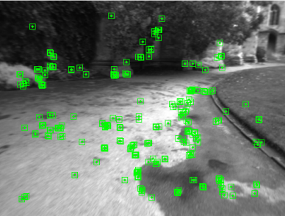
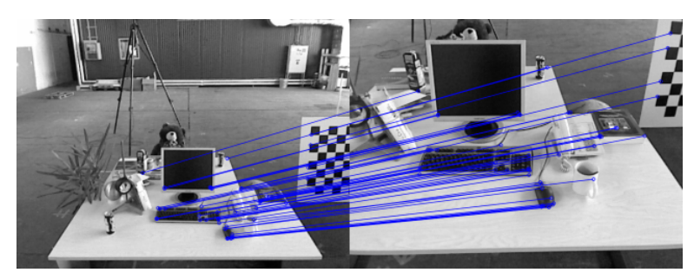
2. Visual Odometry
Feature-based Methods
Steps:
Extract feature key-points and descriptors.
Common features: FAST, SIFT, SURF, ORB
Find the corresponding matches.
Brute-force or kNN match.
Estimate the ego-motion.
PnP or bundle adjustment.
Comments:
Extraction and matching cannot be always guaranteed to be successful.
Tracking may lost if the motion is too fast.
Ego-motion solution does not always exist or global optimal.

Slide 14
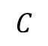
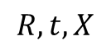
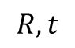
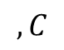
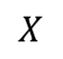
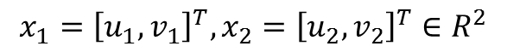
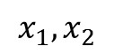
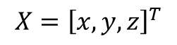
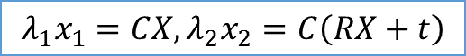
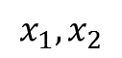
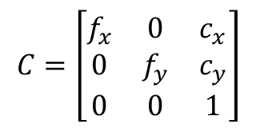
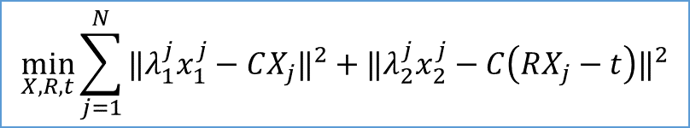
2. Visual Odometry
Ego-motion estimation
Assume a point is observed in two frames whose pixel positions are
Pose from camera 1 to 2: , Camera matrix:
Known: Goal:
Bundle Adjustment: minimization of the re-projection error:
Unfortunately: non-linear, non-convex, on Lie manifold Cannot get a global optimal solution.
$$X$$
$$x_{1},x_{2}$$
$$X={\left[x,y,z\right]}^{T}$$
$$R,t$$
$$C$$
$$x_{1}={\left[u_{1},v_{1}\right]}^{T},x_{2}={\left[u_{2},v_{2}\right]}^{T}∈R^{2}$$
$$λ_{1}x_{1}=CX,λ_{2}x_{2}=C\left(RX+t\right)$$
$$C=\left[\begin{matrix}f_{x} & 0 & c_{x} \\ 0 & f_{y} & c_{y} \\ 0 & 0 & 1\end{matrix}\right]$$
$$x_{1},x_{2}$$
$$,C$$
$$R,t,X$$
$$\min_{X,R,t}\sum_{j=1}^{N}{{‖λ_{1}^{j}x_{1}^{j}−CX_{j}‖}^{2}+{‖λ_{2}^{j}x_{2}^{j}−C\left(RX_{j}−t\right)‖}^{2}}$$

Slide 15
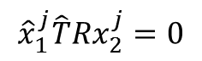

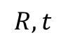
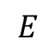
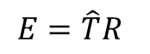
2. Visual Odometry
Feature-based Methods
$$\min_{X,R,t}\sum_{j=1}^{N}{{‖λ_{1}^{j}x_{1}^{j}−CX_{j}‖}^{2}+{‖λ_{2}^{j}x_{2}^{j}−C\left(RX_{j}−t\right)‖}^{2}}$$
How to solve
Via Epipolar Geometry:
Build epipolar constraints:
Find the Essential matrix or fundamental matrix:
Solve from .
Via Optimization:
Guess a good init value (from last frame, constant velocity models or other sensors).
Iterate! (GN or LM)
$${\hat{x}}_{1}^{j}\hat{T}Rx_{2}^{j}=0$$
$$E=\hat{T}R$$
$$R,t$$
$$E$$

Slide 16
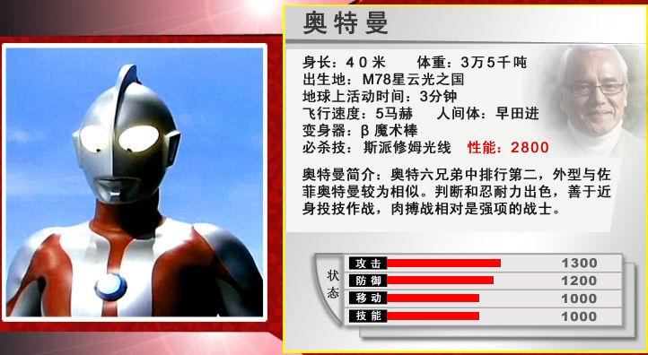
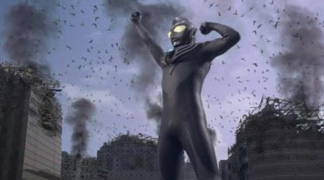
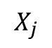
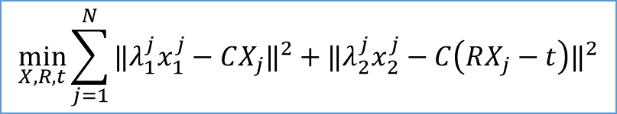
2. Visual Odometry
$$\min_{X,R,t}\sum_{j=1}^{N}{{‖λ_{1}^{j}x_{1}^{j}−CX_{j}‖}^{2}+{‖λ_{2}^{j}x_{2}^{j}−C\left(RX_{j}−t\right)‖}^{2}}$$
Feature-based Methods
Monocular SLAM: reconstruct the 3D points:
Scale indeterminate problem:
Setting relative base-line to 1 => no pure rotation
$$X_{j}$$
4m? 40m? 1.8 m?

Slide 17
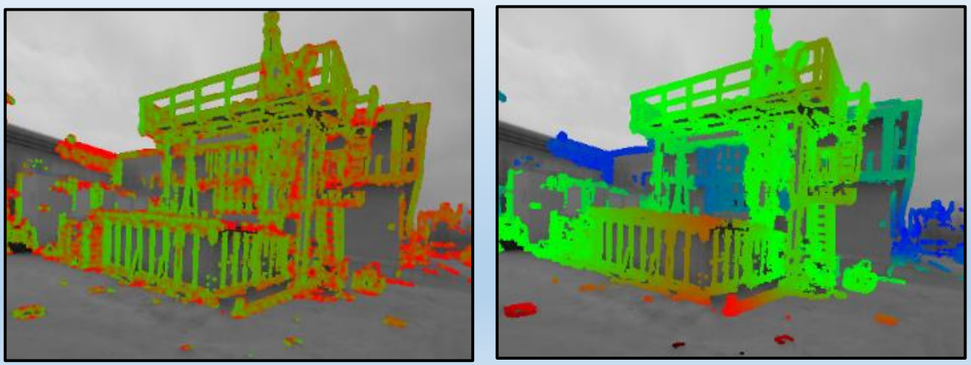
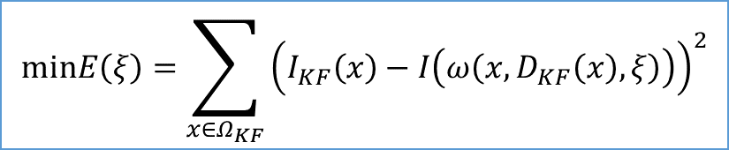
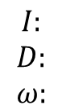
2. Visual Odometry
Direct Methods
Minimization the gray scale values of pixels.
Assume the camera moves slowly, smoothly and the light condition does not change much.
Reconstruct dense results instead of sparse feature points.
$$minE\left(ξ\right)=\sum_{x∈Ω_{KF}}{{\left(I_{KF}\left(x\right)−I\left(ω\left(x,D_{KF}\left(x\right),ξ\right)\right)\right)}^{2}}$$
$$\begin{matrix}I: \\ D: \\ ω:\end{matrix}$$
Image gray scale value
Depth map of pixels
Projection function

Slide 18
2. Visual Odometry
So in visual odometry, we
Track feature points (lines, planes);
Estimate the ego-motion between consecutive frames;
Reconstruct the local map (sparse key-points or dense models);
But they may:
Drift during the motion;
Inconsistent with other parts of environments;
Lost due to occlusion or fast motion.
Solutions
Global optimization
Loop closure
Re-localization

Slide 19
3. Optimization

Slide 20
3. Optimization
Status Variable
In history, we have two kinds of back-ends
Filter
Optimization
In filter methods, we use past information to maintain the current status.
Predict
Extended Kalman Filter
Motion:
Observation:
Update

Slide 21
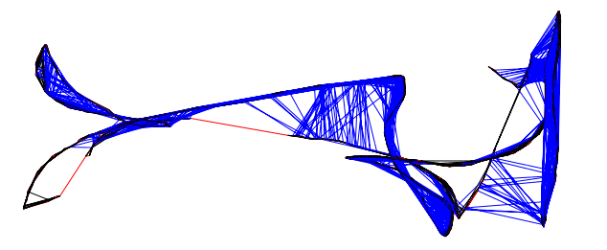
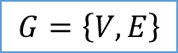
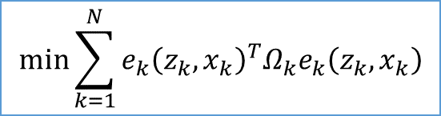
3. Optimization
Full-SLAM or Graph-based SLAM
Considering all the past observations and put them into a large optimization problem.
Usually represented as a Graph:
Vertex: the optimization variables
Edges: the error terms (or constraints)
A large MSE:
Global optimization: reduce the drifts
$$G=\left\{V,E\right\}$$
$$min\sum_{k=1}^{N}{e_{k}{\left(z_{k},x_{k}\right)}^{T}Ω_{k}e_{k}\left(z_{k},x_{k}\right)}$$

Slide 22
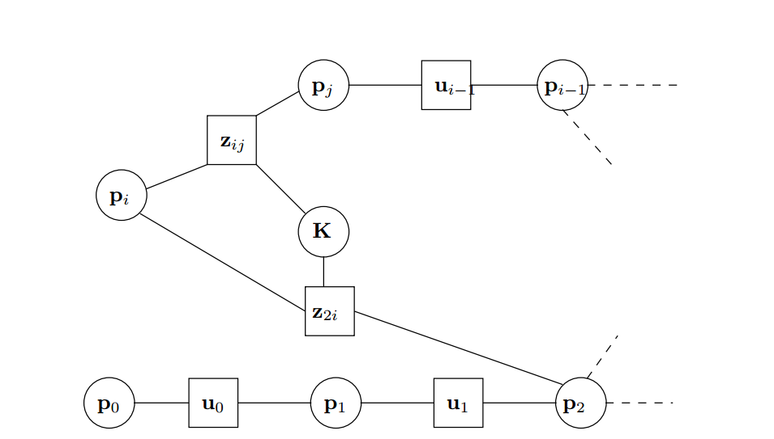
3. Optimization
Put them together to build a error function
Guess a good init value and then iterate it!
Just a large bundle adjustment.
Advantages:
Use more information than filters.
Convenient to represent the loops.
Sparse structure in the graph helps computation!
Mix different vertices and edges!
Disadvantage:
Hard to maintain the graph size.
Global optimization still needs more computation time comparing with filters.
Tools: g2o, ceres, etc.
A sample graph
P: poses of the camera (or robot)
Z: observations
K: uncalibrated parameters
U: motion constraints

Slide 23
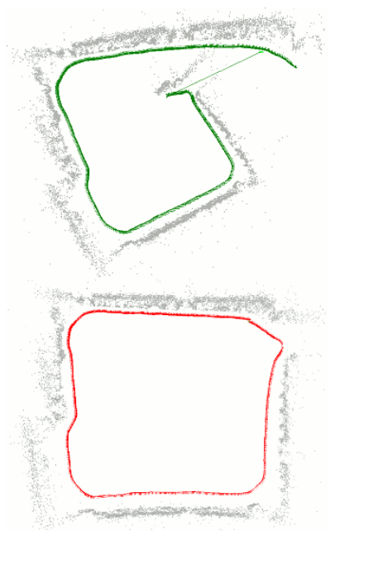
3. Optimization
The loop constraints can help to correct the drift.

Slide 24
3. Optimization
Problems in graph optimization:
What happens if I add wrong edges into the graph?
Robust error term.
What if VO gets lost?
Measurement of the connectivity.
The graph will grow over time.
Long-term SLAM, needs pruning.
How to fuse two different graph?
Multi-robot SLAM.

Slide 25
4. Loop Closure

Slide 26
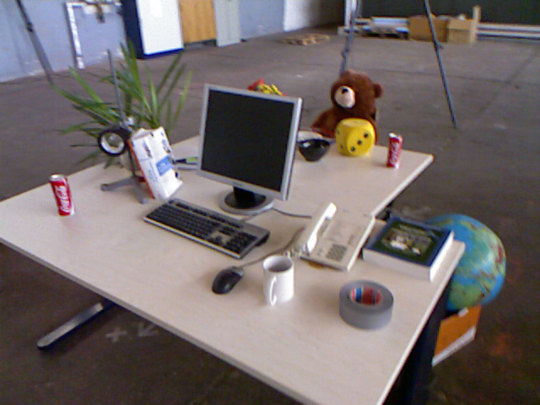
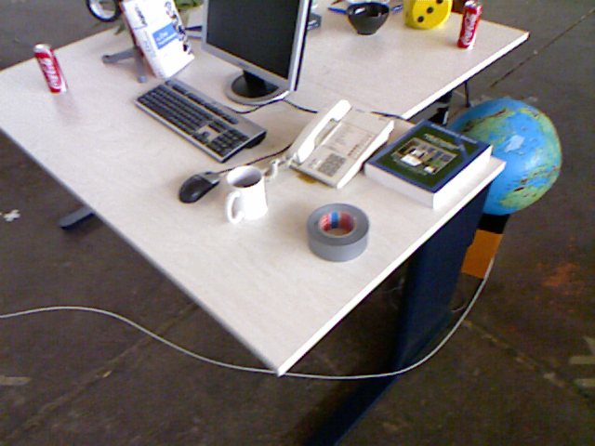
4. Loop Closure
What is loop closure?
To recognize visited places.
VO differs with SLAM because it usually don’t close the loops
Therefore VO will have accumulated drift.

Slide 27


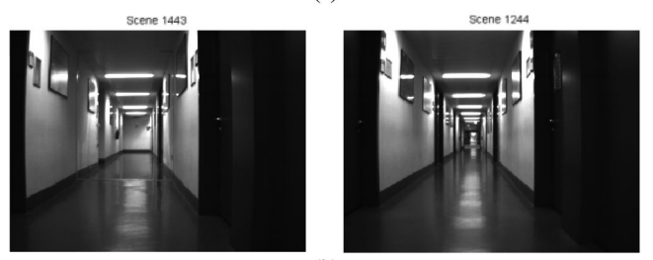
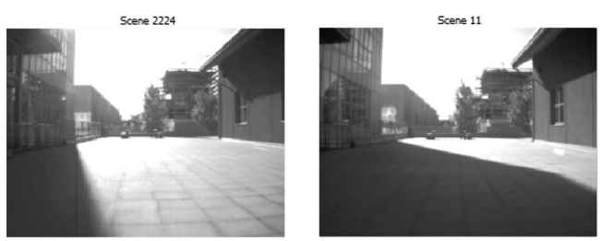
4. Loop Closure
Odometry-based Approaches
Assume the estimated posts are accurate enough.
Recursive in logic.
The Key of closing loops in vSLAM:
Are the positions of cameras near to each other?
Are the images look the same?
Appearance-based Approaches
Only consider the observed image.
State of the art in vSLAM.
YES
Looks same but not
Looks different but the same
False Positive
False Negative

Slide 28
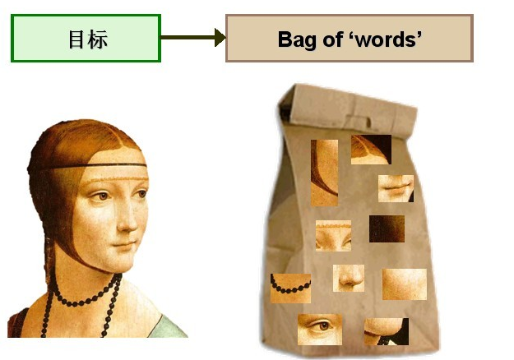
4. Loop Closure
How to measure the similarity of images?
Directly A-B ? -What if the view and light changes?
We need more complicated models: Bag-of-Words
From many images: nose, eyes, hairs, …
Dictionary
Face = 1 nose + 2 eyes + 1 hairs + …
Features -> Words

Slide 29


4. Loop Closure
Bag-of-Words loop closure approaches:
How to evaluate loop closure methods?
Precision-recall curve.
Approaches from ML: Auto-encoders, CNNs, etc.
A large image set
Clustering
Features: SIFT, ORB
Dictionary
Compute Similarity and
Raise loop hypothesis
Image A
Words A= 2 car + 1 people
Image B
Words A= 1 car + 1 cat

Slide 30
5. Map

Slide 31





5. Map
Map is one of the major outputs of SLAM
However it depends on what is SLAM applied for.
Metric map
Topological map
Others

Slide 32
5. Map
In mapping we seek an efficient way to represent the environment.
Metric Maps
Accurate
Navigation
Hard to extend
Expensive in storage
Examples:
Grid map
Occupancy map
Raw point cloud map
Topological Maps
Flexible
Low-cost
Inaccurate
Need local models to navigate

Slide 33


5. Map
Maps used in Navigation:
Occupancy maps: model the possibility if a point is occupied
2D Occupancy map (ROS)
3D Occupancy map (Octomap)

Slide 34


5. Map
Maps used in Reconstruction:
TSDF (Truncated signed distance function)
Surfels

Slide 35
6. Conclusion

Slide 36

6. Conclusion
In a typical SLAM system, we use
VO to estimate the ego-motion between frames
Optimization to handle the global trajectory
Loop closure to correct the draft
Map to describe the environment
Is that all about SLAM?
We haven’t talked about coding yet.

Slide 37
6. Conclusion
Qualified open-source SLAM solutions
Name | Site
Rgbd-slam-v2 | https://github.com/felixendres/rgbdslam_v2
ORB-slam | https://github.com/raulmur/ORB_SLAM
LSD-slam | https://github.com/tum-vision/lsd_slam
Hector-slam | https://github.com/tu-darmstadt-ros-pkg/hector_slam
SVO | https://github.com/uzh-rpg/rpg_svo
RTABslam | https://github.com/introlab/rtabmap_ros#rtabmap_ros
Dvo-slam | https://github.com/tum-vision/dvo_slam
Kinect Fusion | http://research.microsoft.com/en-us/projects/surfacerecon/
Kinfu_large_scale | http://pointclouds.org/documentation/tutorials/using_kinfu_large_scale.php
DTAM | https://github.com/anuranbaka/OpenDTAM

Slide 38
6. Conclusion
For a student starting to work in SLAM, one should learn:
Math: geometry, probabilistic even ML
Coding skills:
Linux
C++
Libraries: ROS, OpenCV, PCL, g2o, DBoW2, libpointmatcher, octomap, Fabmap, ceres …
Python
Future issuses:
Dynamic, Multi-robots, Semantic, Low-weight devices, Mobile platforms

Slide 39
Thank you for attention!

